Slide 1


Optimization and Analysis of Sorting Algorithms: A Comparative Study
Sorting algorithms play a fundamental role in computer science, enabling the efficient organization of data. This presentation explores the key characteristics, performance analysis, and practical implications of various sorting algorithms. We will delve into the inner workings of fundamental sorting algorithms, analyzing their time and space complexity, stability, and in-place nature. We will also examine their suitability for different data sizes and explore the use of hybrid approaches to enhance sorting efficiency.
A. Sarvani Kanyaka-192211795
C. Aswini Chowdary-192211442

Slide 2

Fundamental Sorting Algorithms
1
Selection Sort
2
Insertion Sort
Selection sort works by repeatedly selecting the minimum element from the unsorted subarray and swapping it with the element at the current position. It is an in-place sorting algorithm with a time complexity of O(n^2) for both best and worst cases.
Insertion sort builds the sorted array one element at a time. It iterates through the input array and inserts each element into its correct position in the sorted subarray. Its time complexity is O(n^2) in the worst case but can reach O(n) for nearly sorted arrays.
3
Bubble Sort
4
Merge Sort
Bubble sort compares adjacent elements and swaps them if they are in the wrong order. It repeatedly steps through the list, comparing each pair of adjacent elements and swapping them if they are in the wrong order. It has a time complexity of O(n^2) for all cases.
Merge sort is a recursive divide-and-conquer algorithm that splits the input array into halves until it has individual elements, then merges them back in sorted order. It has a time complexity of O(n log n) for all cases and is a stable sorting algorithm.

Slide 3
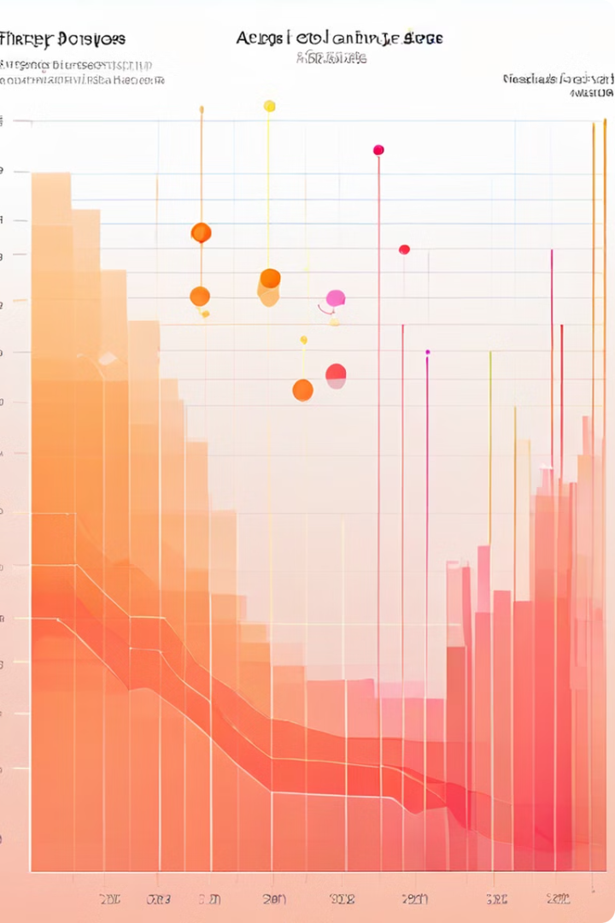
Time Complexity Analysis
Algorithm
Best Case
Average Case
Worst Case
Selection Sort
O(n^2)
O(n^2)
O(n^2)
Insertion Sort
O(n)
O(n^2)
O(n^2)
Bubble Sort
O(n)
O(n^2)
O(n^2)
Merge Sort
O(n log n)
O(n log n)
O(n log n)
Quick Sort
O(n log n)
O(n log n)
O(n^2)
Heap Sort
O(n log n)
O(n log n)
O(n log n)

Slide 4
Space Complexity Analysis
In-Place Sorting
Out-of-Place Sorting
Space Complexity Comparison
In-place sorting algorithms modify the original input array directly without requiring additional storage. This makes them memory-efficient but can limit their flexibility. Examples include Selection Sort, Insertion Sort, and Bubble Sort.
Out-of-place sorting algorithms require additional memory to store intermediate results. This allows them to work more flexibly but can increase memory consumption. Examples include Merge Sort and Quick Sort.
In-place sorting algorithms typically have a space complexity of O(1), while out-of-place sorting algorithms can have a space complexity of O(n) or O(log n) depending on the implementation.

Slide 5

Comparison of Sorting Algorithms
Algorithm
Time Complexity
Space Complexity
Stable
In-Place
Use Cases
Selection Sort
O(n^2)
O(1)
No
Yes
Simple, small datasets
Insertion Sort
O(n^2) (worst case)
O(1)
Yes
Yes
Nearly sorted arrays, small datasets
Bubble Sort
O(n^2)
O(1)
Yes
Yes
Simple, small datasets
Merge Sort
O(n log n)
O(n)
Yes
No
Large datasets, stable sorting required
Quick Sort
O(n log n) (average case)
O(log n) (average case)
No
Yes
Large datasets, efficient in practice
Heap Sort
O(n log n)
O(1)
No
Yes
Large datasets, in-place sorting

Slide 6



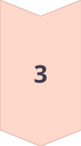
Stability and In-place Sorting
Stability
Stability in sorting refers to the preservation of the relative order of elements with equal values. Stable sorting algorithms ensure that equal elements maintain their original order in the sorted output. Examples of stable sorting algorithms include Insertion Sort, Merge Sort, and Bubble Sort.
In-Place Sorting
In-place sorting algorithms modify the input array directly, without requiring additional storage for intermediate results. This minimizes memory consumption, making them suitable for scenarios with limited memory. Examples of in-place sorting algorithms include Selection Sort, Insertion Sort, and Heap Sort.
Practical Implications
The stability and in-place nature of sorting algorithms can influence their suitability for specific applications. Stable sorting is often crucial for maintaining data integrity, while in-place sorting is advantageous for memory efficiency.

Slide 7

Sorting Algorithms for Large Data Sets
1
Merge Sort
Merge sort is a highly efficient sorting algorithm for large datasets. Its O(n log n) time complexity ensures predictable performance even with massive data volumes. Its stability is an added advantage for certain applications.
2
Quick Sort
Quick sort is another efficient sorting algorithm for large datasets. While its worst-case time complexity is O(n^2), its average case performance is O(n log n), making it a strong choice for many practical scenarios.
3
Heap Sort
Heap sort is a good choice for large datasets when in-place sorting is required. It offers O(n log n) time complexity, but it is not stable. Its in-place nature makes it suitable for memory-constrained environments.
4
Radix Sort
Radix sort is a non-comparison-based sorting algorithm that can be highly efficient for large datasets of integers. Its time complexity is O(nk) where n is the number of elements and k is the number of digits. It is not a stable sorting algorithm.

Slide 8

Hybrid Sorting Algorithms
Merge Sort & Insertion Sort
Combining Merge Sort with Insertion Sort creates a hybrid algorithm that leverages the strengths of both. Merge Sort efficiently handles larger subarrays, while Insertion Sort optimizes sorting within smaller subarrays. This approach provides a good balance between efficiency and practicality.
Quick Sort & Insertion Sort
Another common hybrid approach combines Quick Sort with Insertion Sort. Quick Sort efficiently handles larger partitions, while Insertion Sort excels at sorting smaller partitions. This combination often leads to improved performance for various data distributions.
TimSort
TimSort is a hybrid sorting algorithm widely used in Python. It combines the efficiency of Merge Sort with the adaptability of Insertion Sort. It is known for its performance on various data distributions, including already sorted or nearly sorted data.

Slide 9
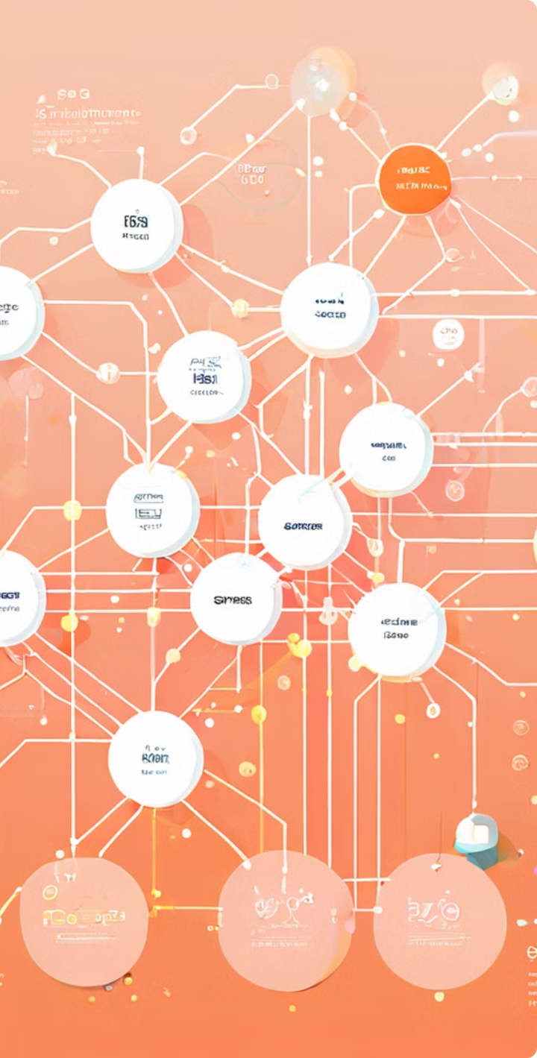




Practical Considerations in Sorting
Memory Constraints
The available memory is a crucial factor when selecting a sorting algorithm. In-place algorithms like Selection Sort, Insertion Sort, and Heap Sort are suitable for memory-constrained environments. Out-of-place algorithms like Merge Sort and Quick Sort may require additional memory.
Data Distribution
The distribution of data in the input array significantly affects the performance of certain sorting algorithms. For example, Insertion Sort is highly efficient for nearly sorted arrays, while Quick Sort generally performs well for random data.
Performance Requirements
The required performance level determines the appropriate choice of sorting algorithm. Algorithms like Merge Sort, Quick Sort, and Heap Sort offer O(n log n) time complexity, making them suitable for high-performance applications.
Stability Requirements
The stability of the sorting algorithm is important when preserving the relative order of elements with equal values. Stable sorting algorithms like Insertion Sort and Merge Sort are crucial for certain applications where data integrity is paramount.

Slide 10

Conclusion and Future Directions
The field of sorting algorithms is constantly evolving. Researchers continue to explore new algorithms and optimizations for improved efficiency. Future directions include developing more efficient algorithms for massive datasets, exploring novel approaches to handle complex data structures, and adapting sorting algorithms to the ever-increasing complexities of modern computing environments. By understanding the fundamentals and nuances of various sorting algorithms, we can make informed choices to optimize our data management and processing, ultimately leading to more efficient and powerful computing systems.

Slide 11


